Slide 1
Xerox® VersaLink® C8000W
Color Printer Featuring White Toner
Print incredible images on colored media

Slide 2
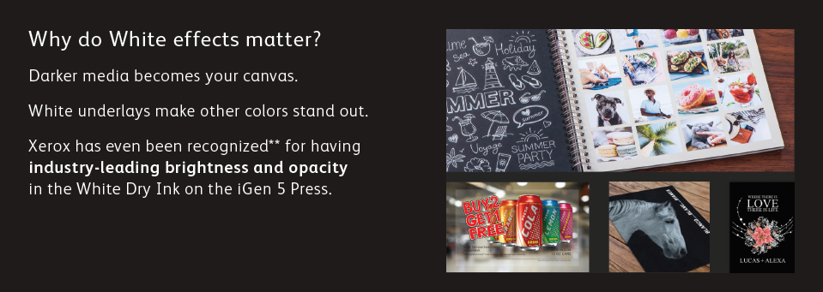
Why print with White?
Why do White effects matter?
Darker media becomes your canvas.
White underlays make other colors stand out.
Xerox White toner with C8000W offers industry-leading brightness and
opacity for incredible print quality.
To a graphics company, differentiating prints from a competitor can be difficult because CMYK technology is used throughout the industry. This technology does not allow good quality printing on anything except white media.
By incorporating white toner used as an underlay, the C8000W enables printing on dark and colored media because the white toner becomes the canvas for the CMY toners – meaning prints pop out as they would on white paper. This is a huge differentiation for the customer base and brings much higher value in the prints and greater profit opportunity.
What’s more, this is in a single pass not requiring any toner changes in the device, making short runs very efficient and cost-effective.

Slide 3
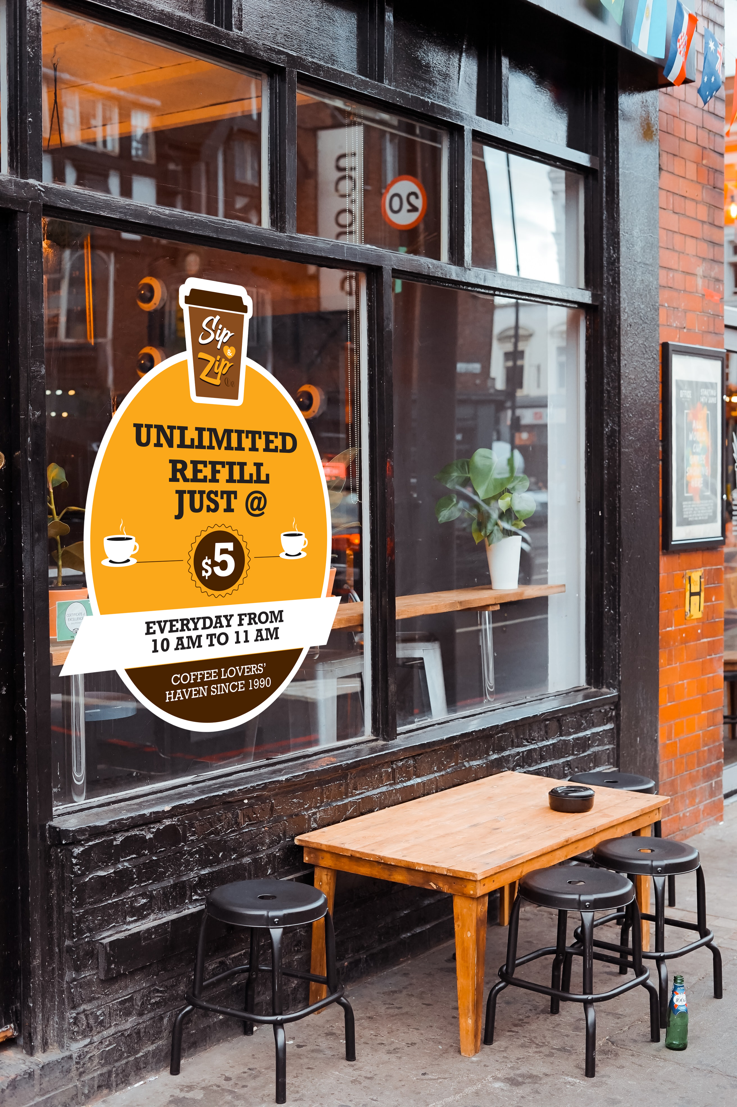



Why print with white toner?
Printing with white toner helps you accentuate
text by making CMYK images prominent on dark and colored media, and window clings
Explore new business opportunities by offering differentiated prints to get
you noticed.

Slide 4
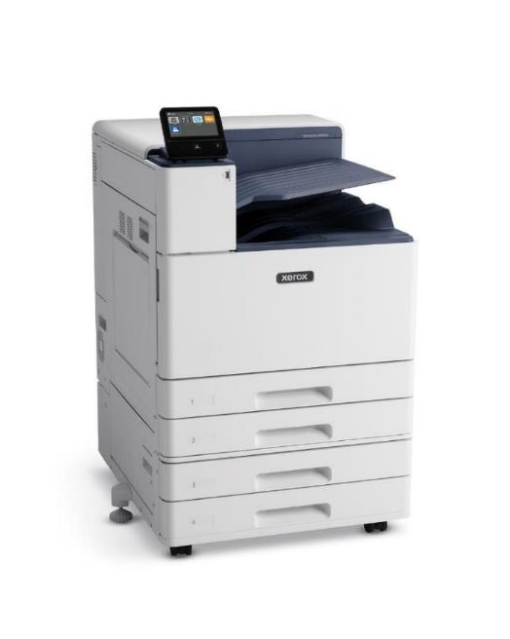
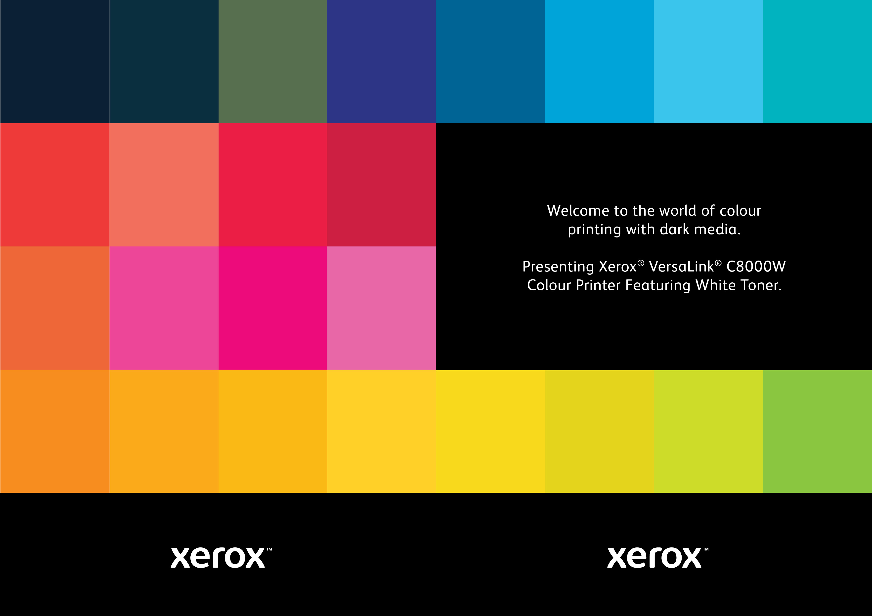
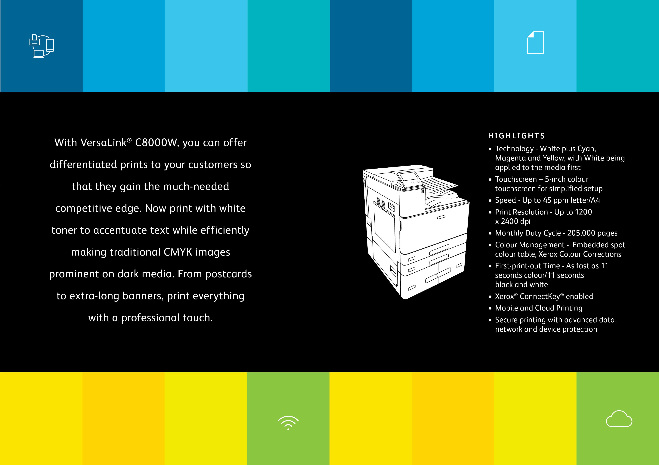
Introducing VersaLink® C8000W Color Printer
Technology
White plus Cyan, Magenta, and Yellow, in a single pass with White being applied to the media first as an underlay
Supports white toner workflows with
Integrated graphics controller
Mac and Windows drivers
Built-in color tables
C8000W plus Two Tray Module

Slide 5
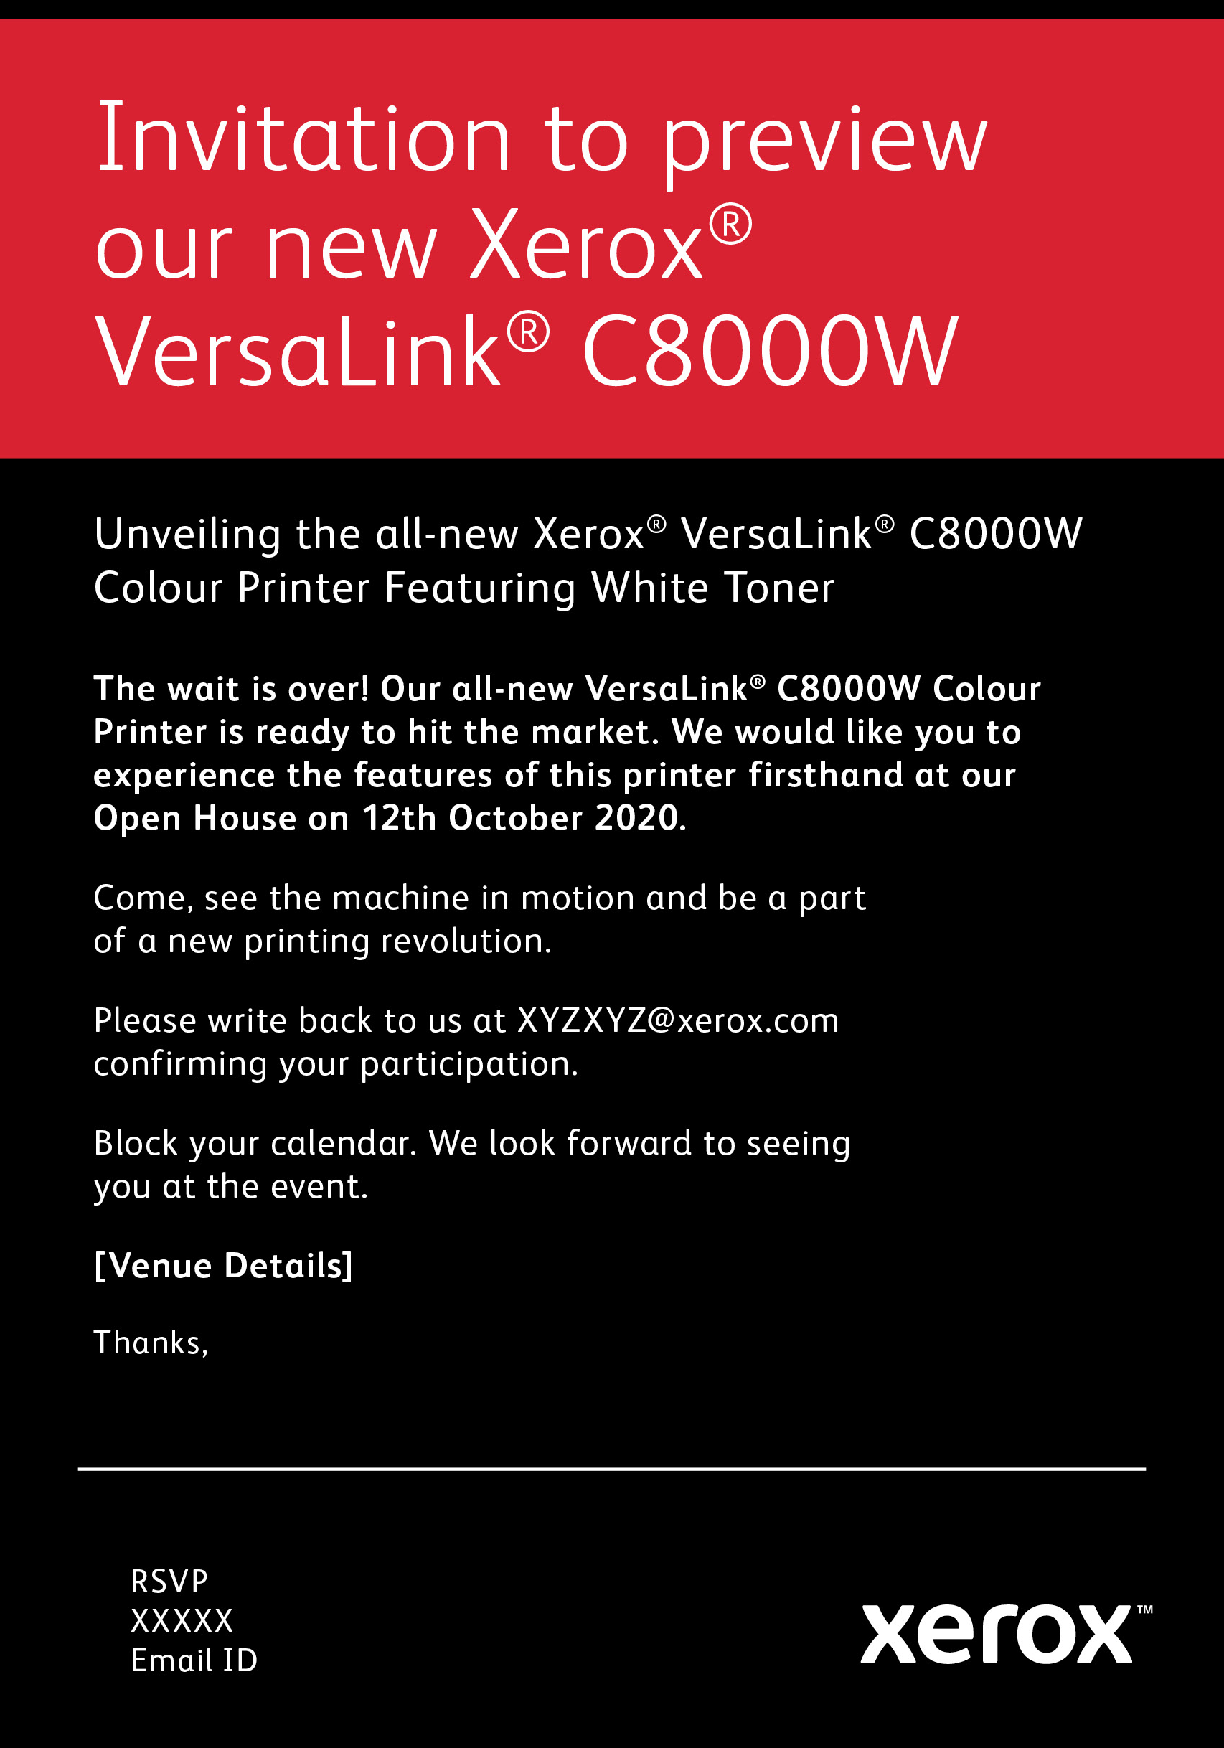
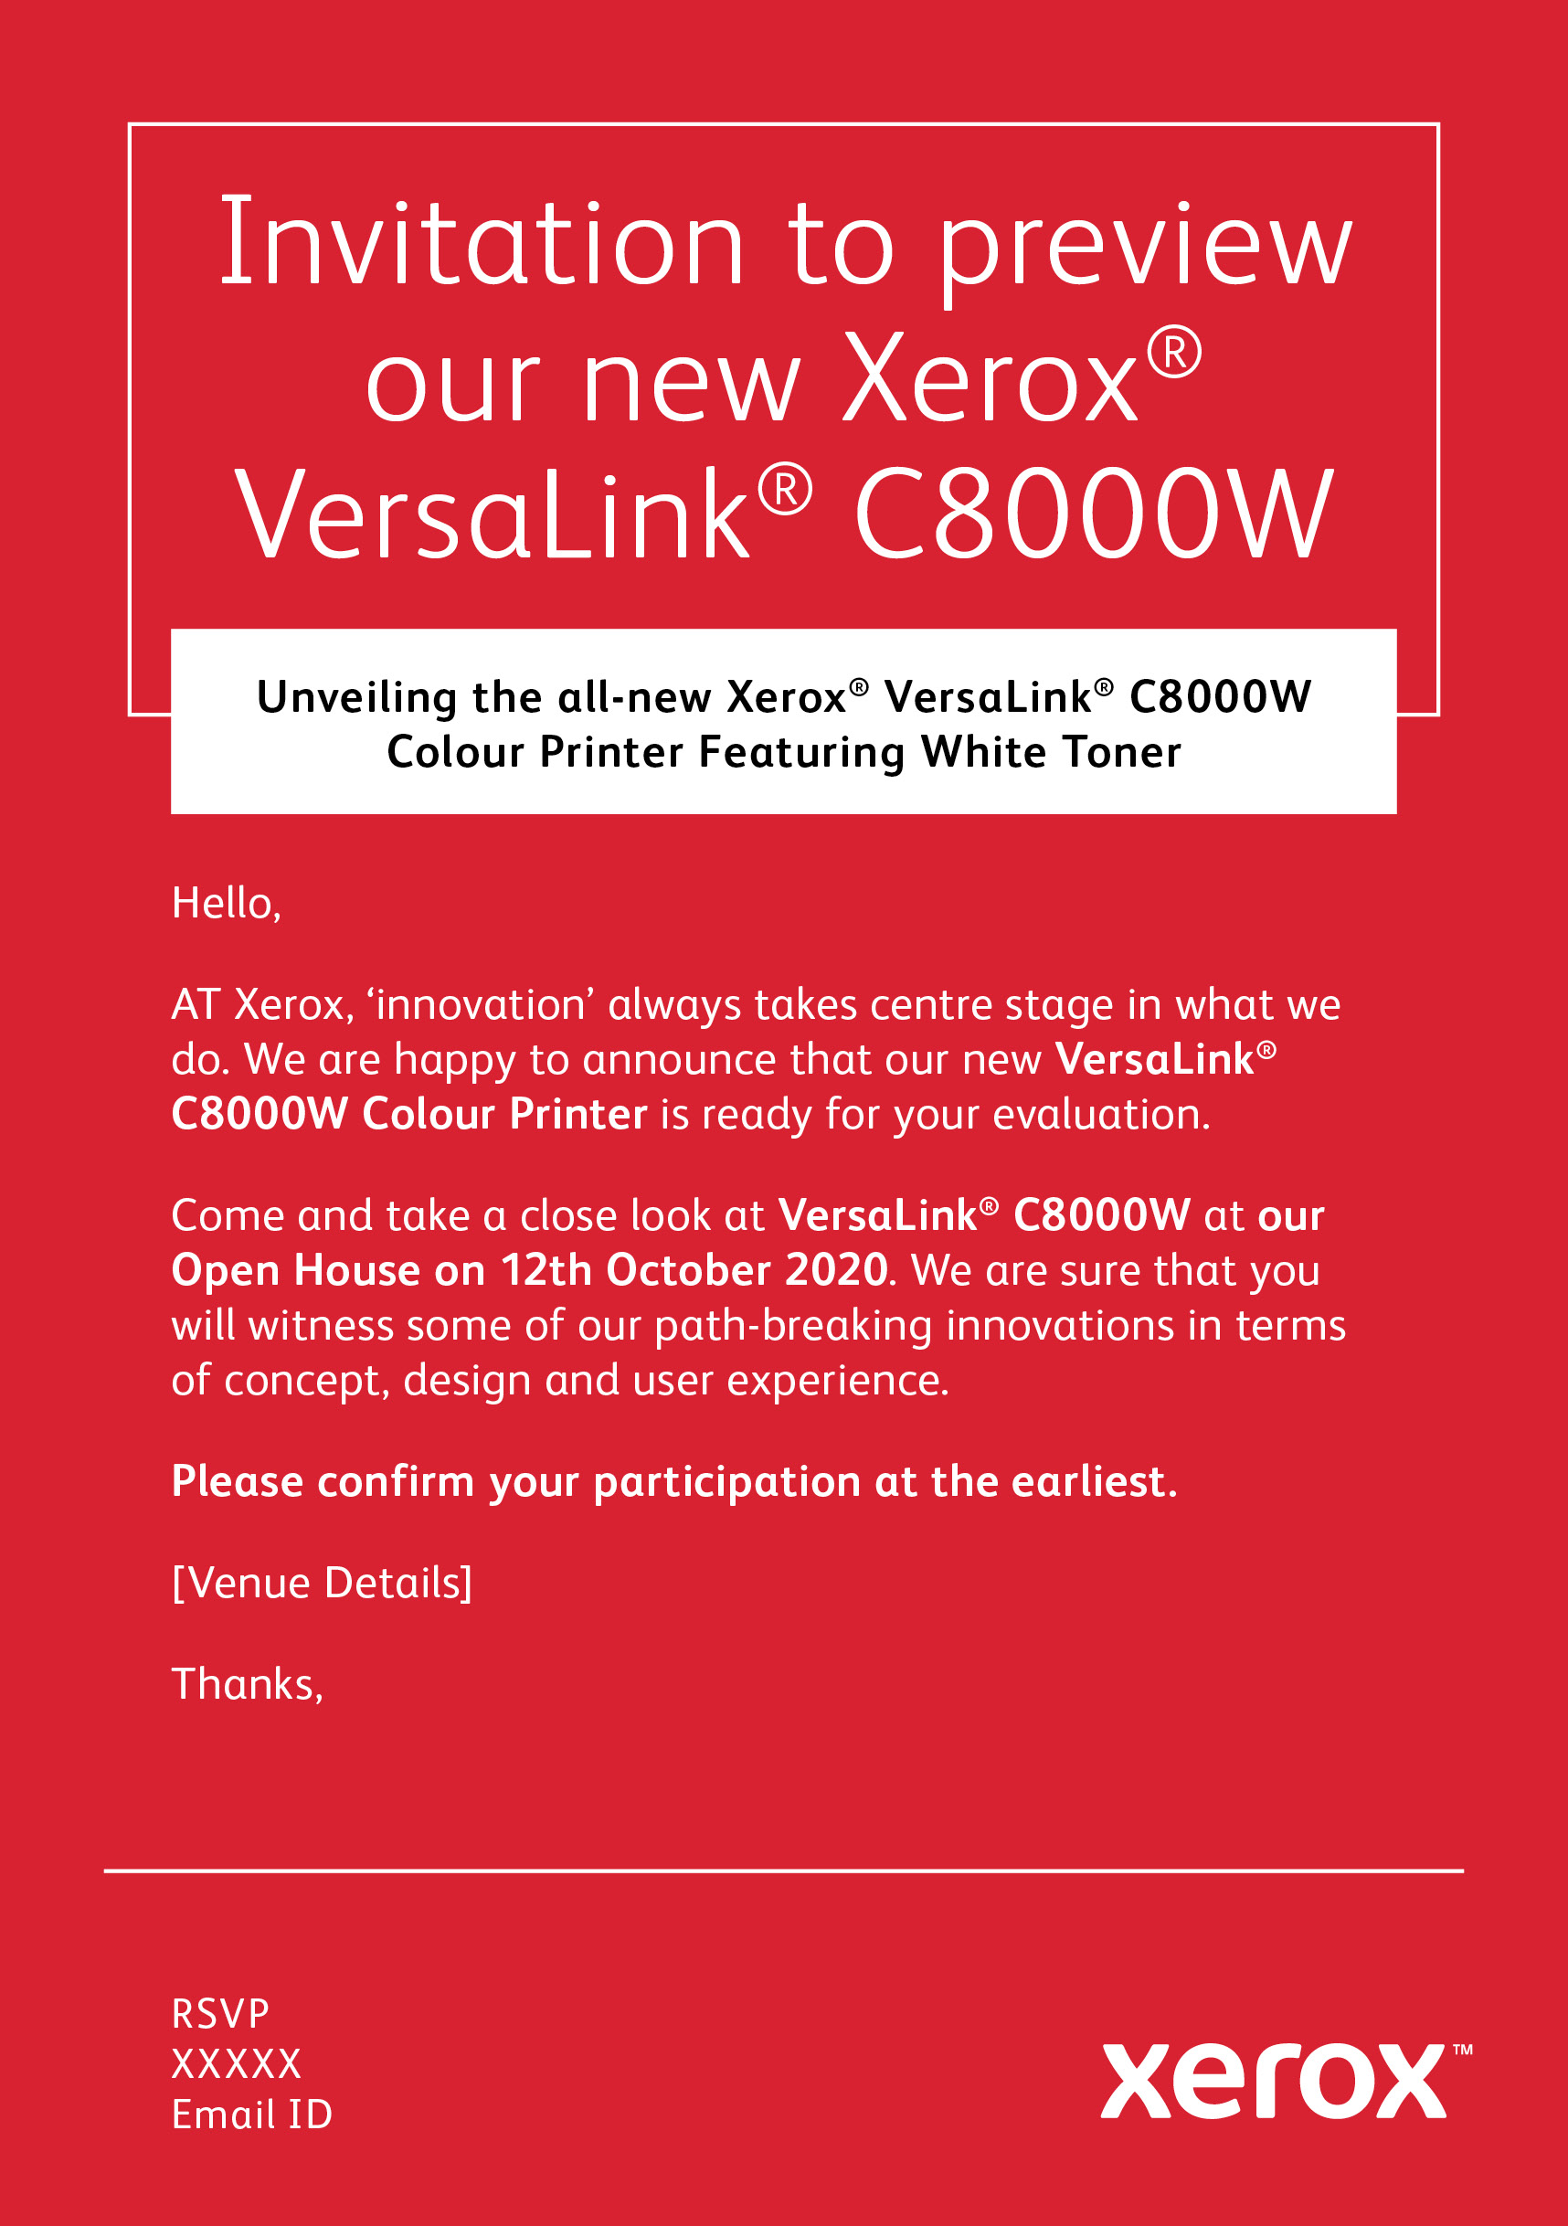
Unleash your creativity with VersaLink® C8000W Color Printer
Designers can use their complete color pallets for work no matter what media color is required with no drop in print quality
Capture your customers’ attention with professional-grade images

Slide 6
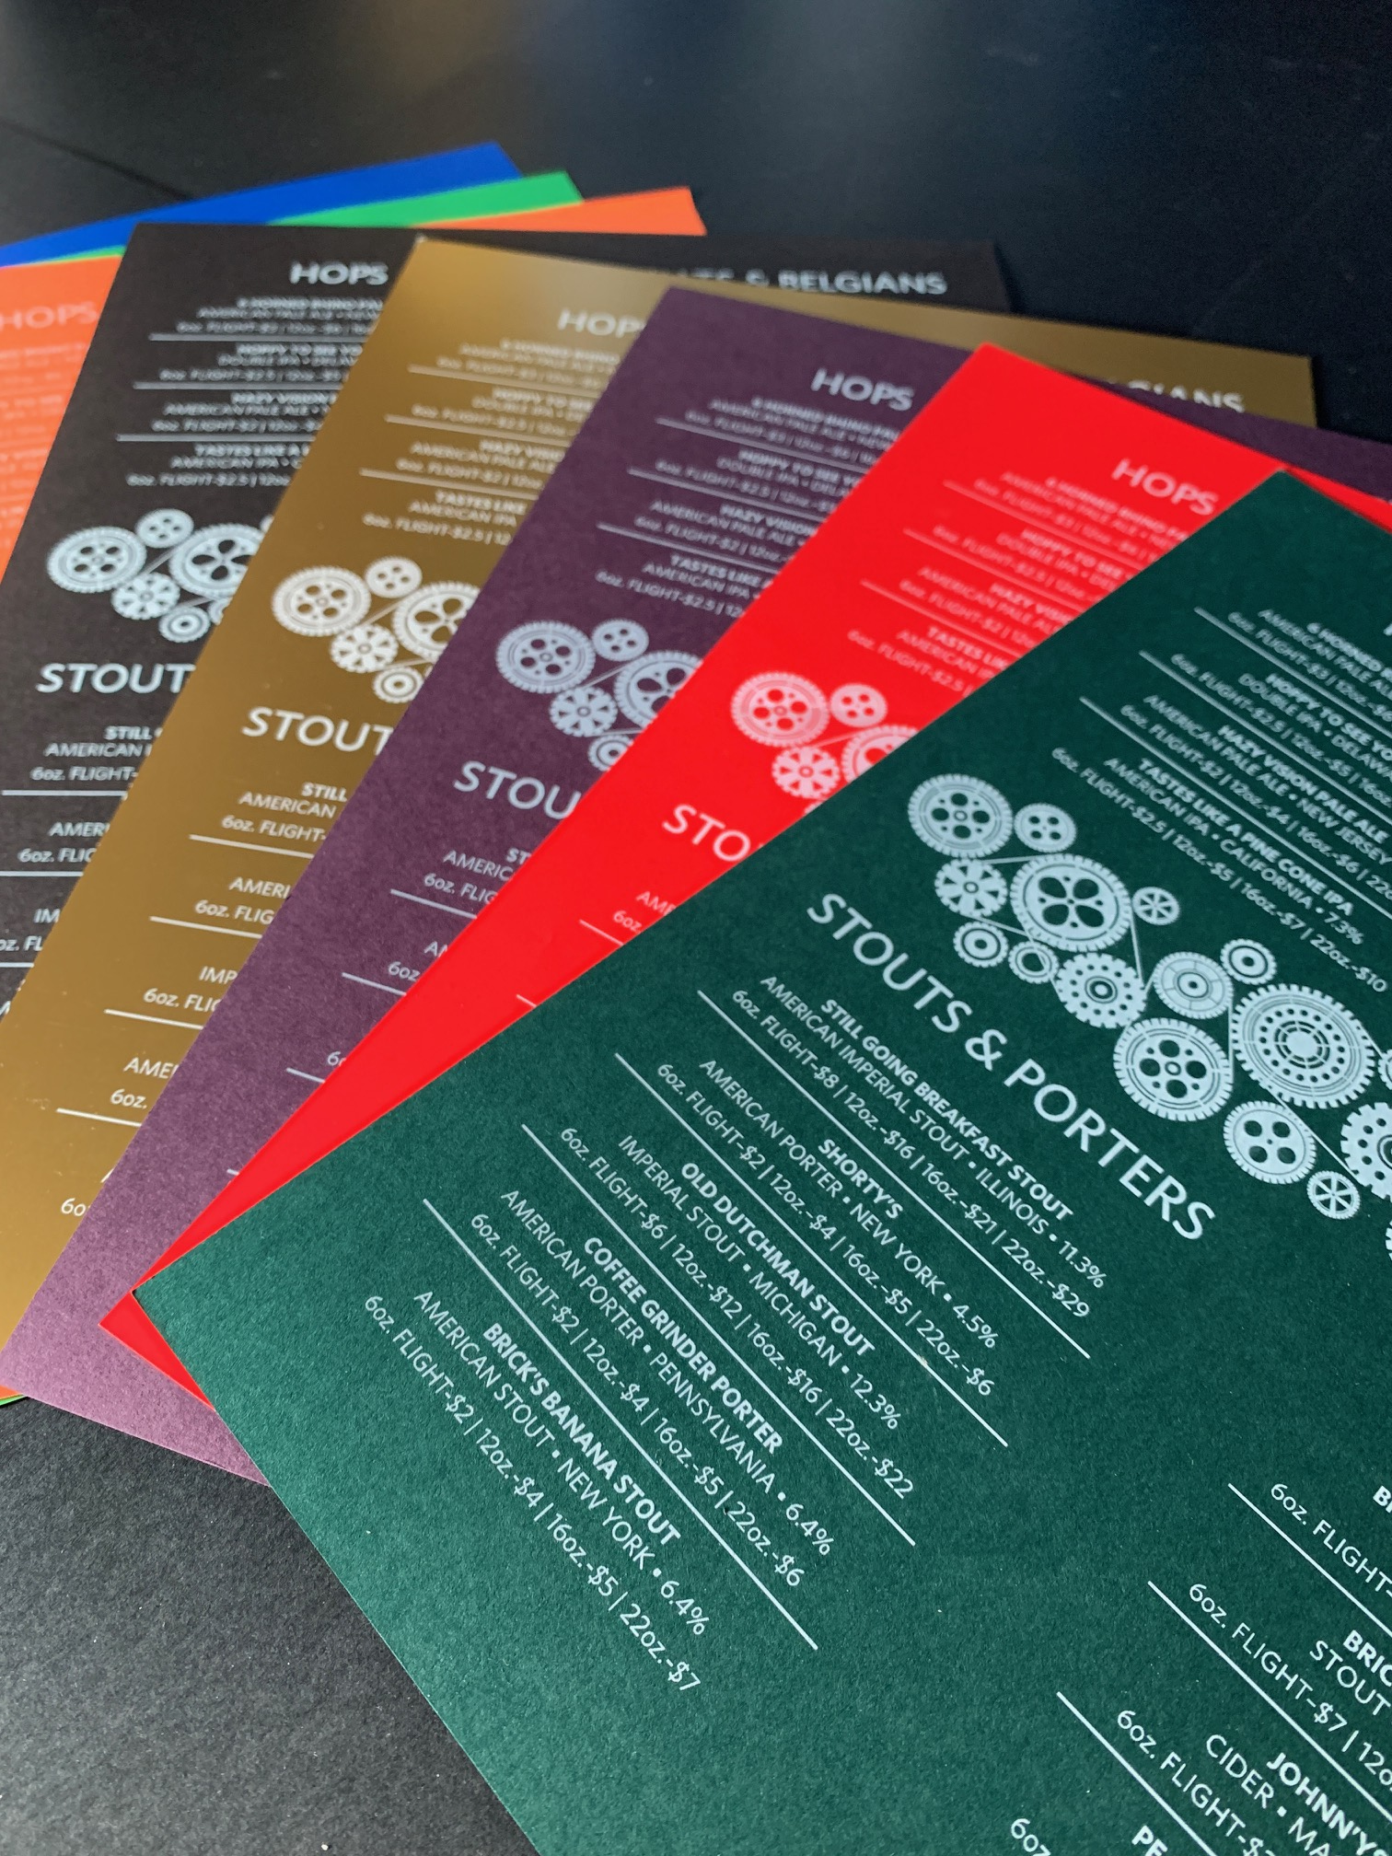
What can you do with VersaLink® C8000W Color Printer?
Dark and colored media/
envelope printing
Wedding invitations, restaurant menus, and banners
Window signs, decals, and labels
Impress your customers with
the use of media not available
to you before

Slide 7
VersaLink® C8000W Color Printer is
built on Xerox®
ConnectKey® Technology
Intuitive user experience
Mobile and cloud connectivity
Comprehensive security
Enables intelligent
workplace services
Gateway to new possibilities

Slide 8
Xerox® VersaLink® C8000W Color Printer Highlights
White plus CMY color printer with integrated controller
45 ppm letter/A4, 22 ppm tabloid
Adobe® PostScript® 3
12 different color media settings
Print standard sizes up to SRA3 documents and banners up to 320x1320mm. 64-300 gsm stock
5” capacitive color touchscreen UI
UI features mobile-like navigation, full personalization
Up to 1200 x 2400 dpi print resolution with true Adobe
PostScript (standard)
1,140 sheet standard paper capacity, up to 5,140 sheets total
(3,140 sheets shown)
Optional feeding and finishing available

